Slide 1
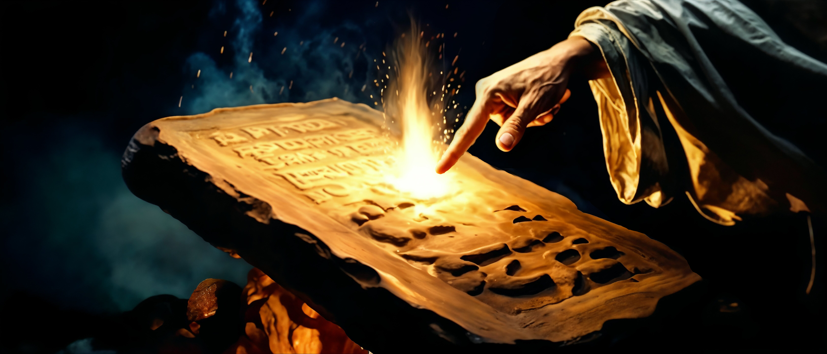
Is the Law a Transcription of God’s Character?

Slide 2

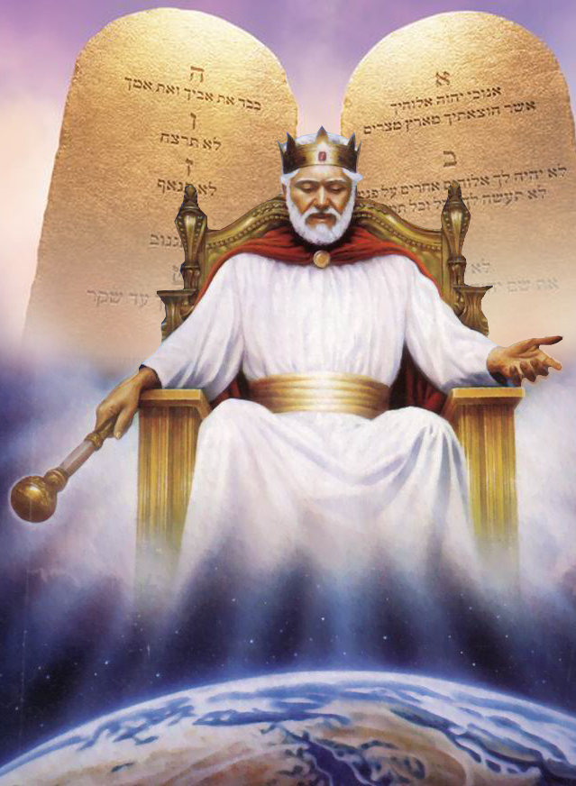
God’s law is the transcript of His character, and those only who obey this law will be accepted by Him. Every departure from obedience to the law of God is rebellion. It is for the highest interest of man to obey the law of God, for conformity to the principles of this law is essential to the formation of a righteous character. The rules of life that the Lord has given will make men pure and happy and holy. Those only who obey these rules can hear from the lips of Christ the words, “Come up higher.” HP 361. The Review and Herald, March 15, 1906.
Is the law truly a reflection of God's character? Does the Bible support this idea?
In this presentation, we will compare Divine qualities with the qualities of the law to discover the similarities between them.

Slide 3



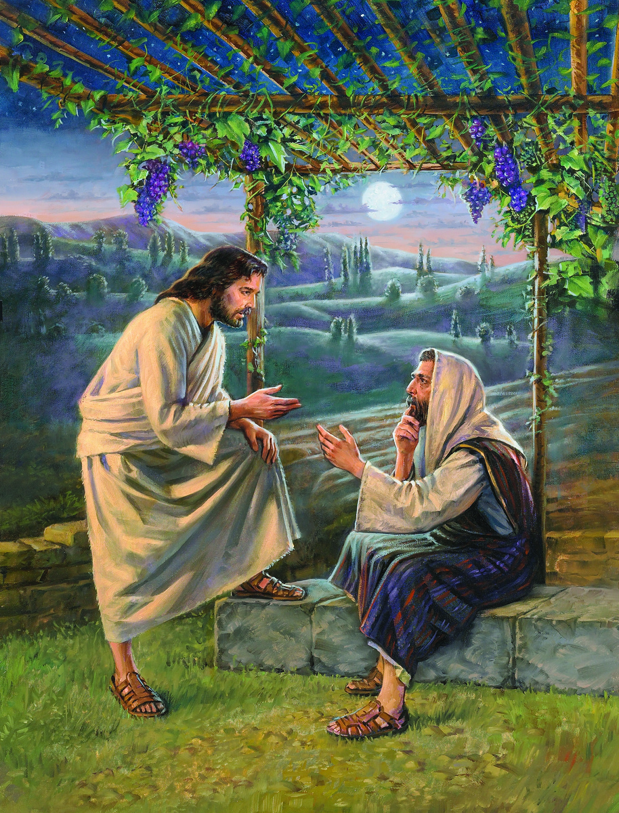
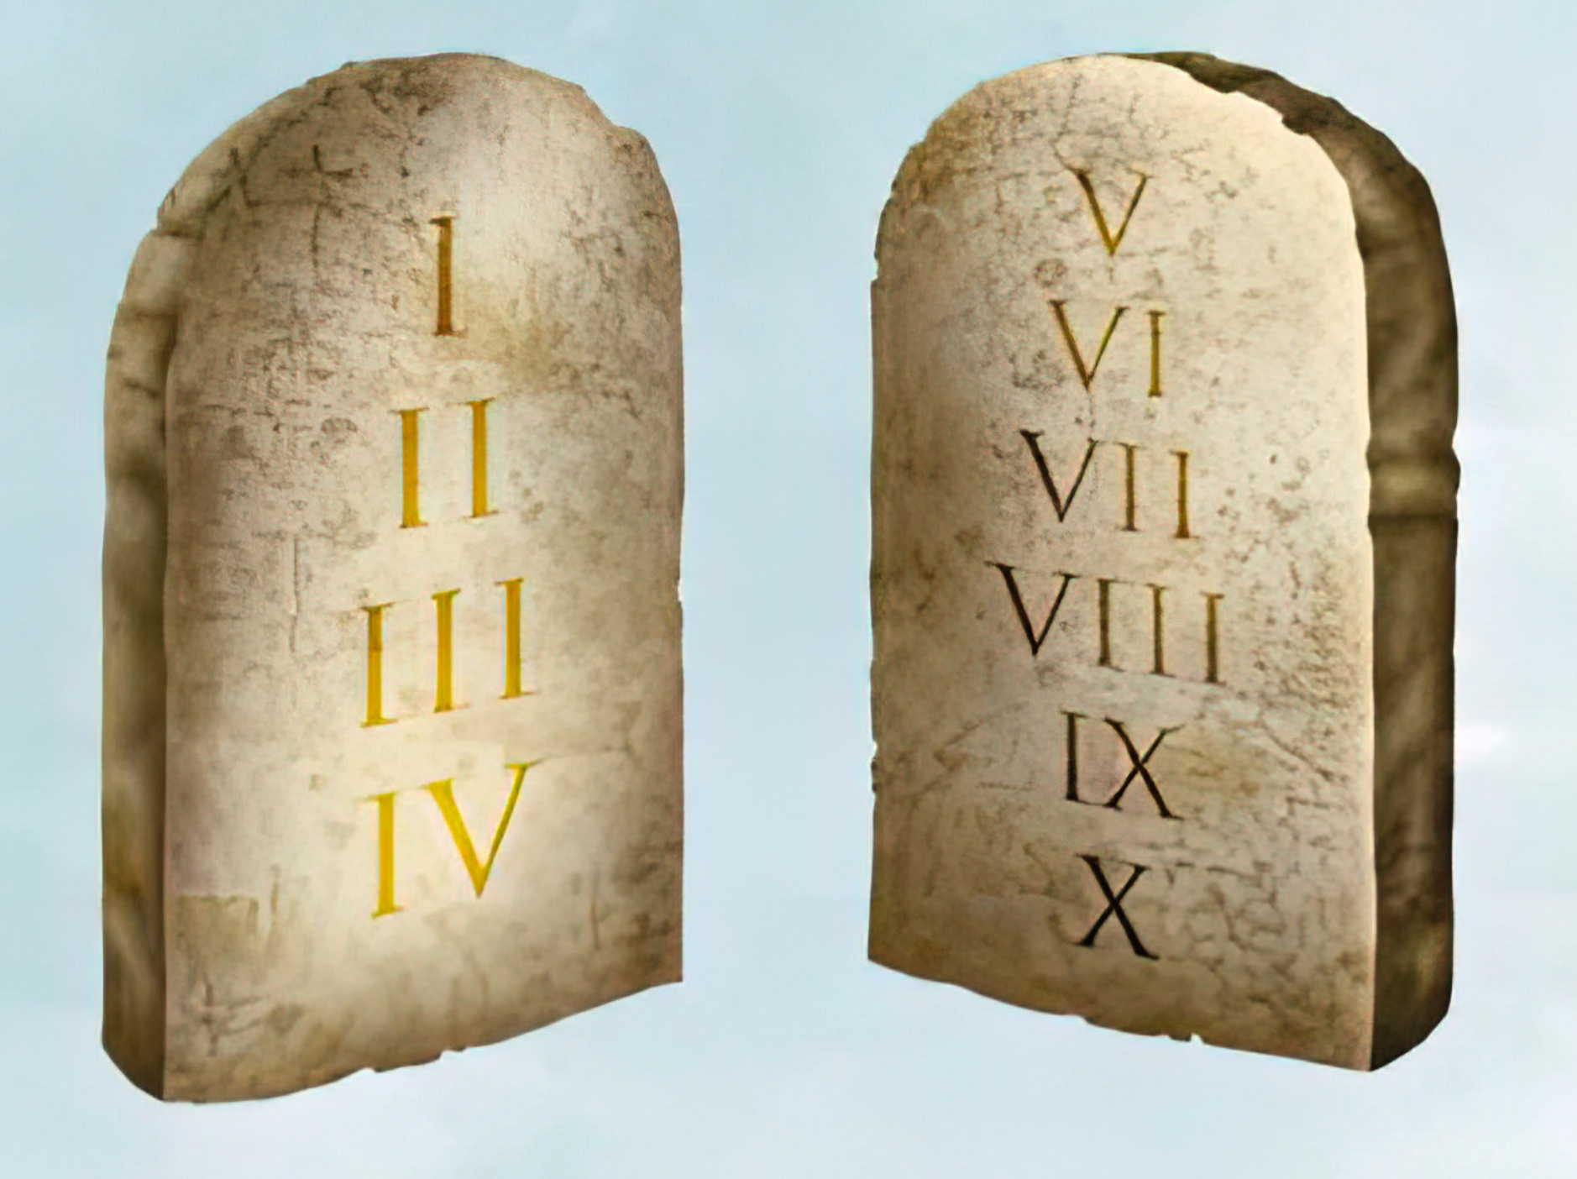
1
GOD IS GOOD
THE LAW IS GOOD
A
And Jesus said unto him, Why callest thou me good? none is good, save one, that is, God. (Luke 18:19)
Wherefore the law is holy, and the commandment holy, and just, and good. (Romans 7:12)

Slide 4




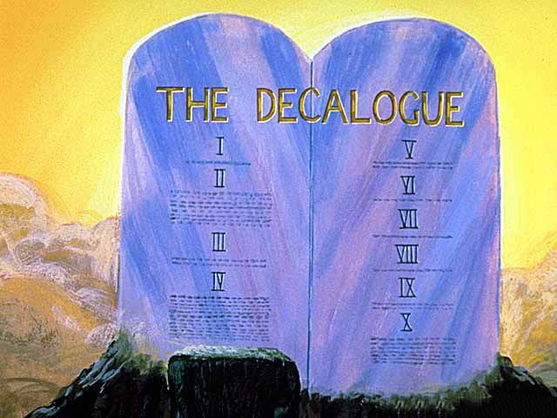
2
GOD IS HOLY
THE LAW IS HOLY
B
And ye shall be holy unto me: for I the LORD am holy, and have severed you from other people, that ye should be mine. (Leviticus 20:26)
Wherefore the law is holy, and the commandment holy, and just, and good. (Romans 7:12)
Because it is written, Be ye holy; for I am holy. (1 Peter 1:16)

Slide 5



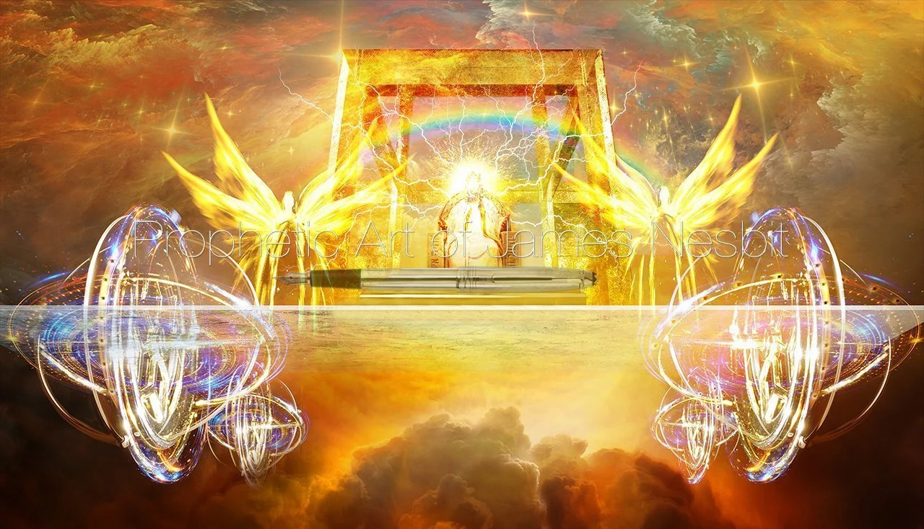
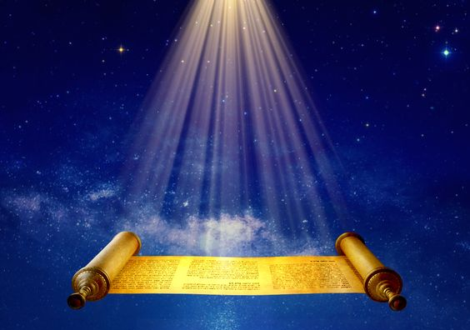
GOD IS PERFECT
THE LAW IS PERFECT
3
C
Be ye therefore perfect, even as your Father which is in heaven is perfect. (Matthew 5:48)
The law of the LORD is perfect, converting the soul: the testimony of the LORD is sure, making wise the simple. (Psalms 19:7)

Slide 6



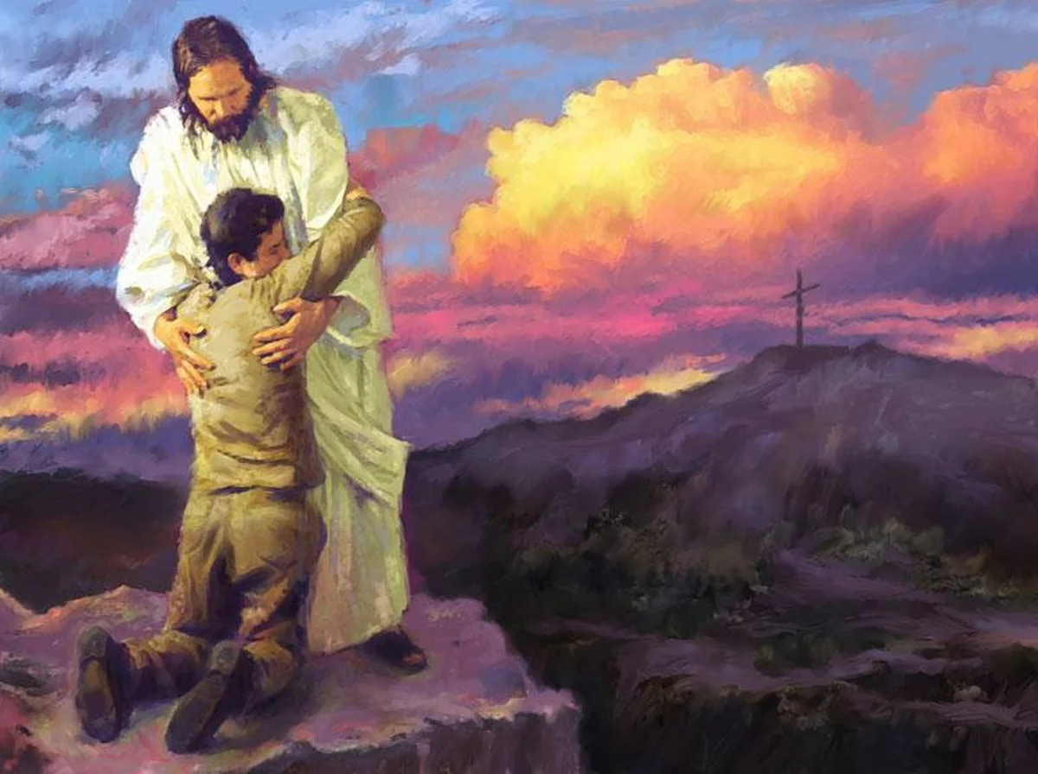

4
D
GOD IS LOVE
THE LAW IS LOVE
He that loveth not knoweth not God; for God is love. (1 John 4:8)
Love worketh no ill to his neighbour: therefore love is the fulfilling of the law. (Romans 13:10)

Slide 7



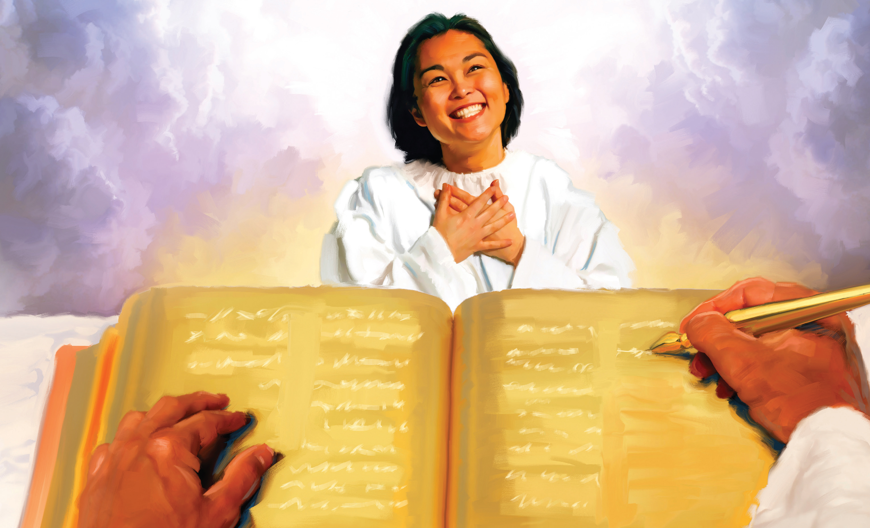
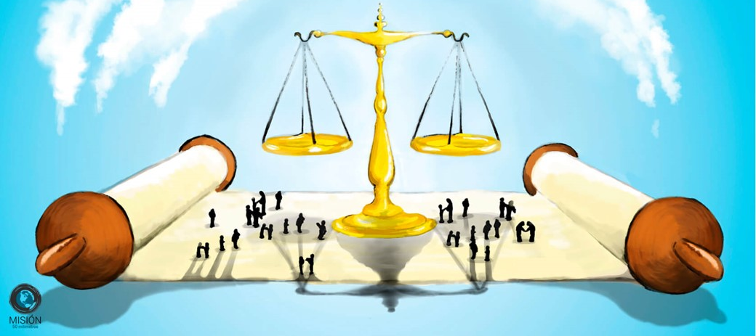
5
GOD IS JUST
THE LAW IS JUST
E
Wherefore the law is holy, and the commandment holy, and just, and good. (Romans 7:12)
For God is not unrighteous to forget your work and labour of love, which ye have shewed toward his name, in that ye have ministered to the saints, and do minister. (Hebrews 6:10)
My tongue shall speak of thy word: for all thy commandments are righteousness. (Psalms 119:172)

Slide 8


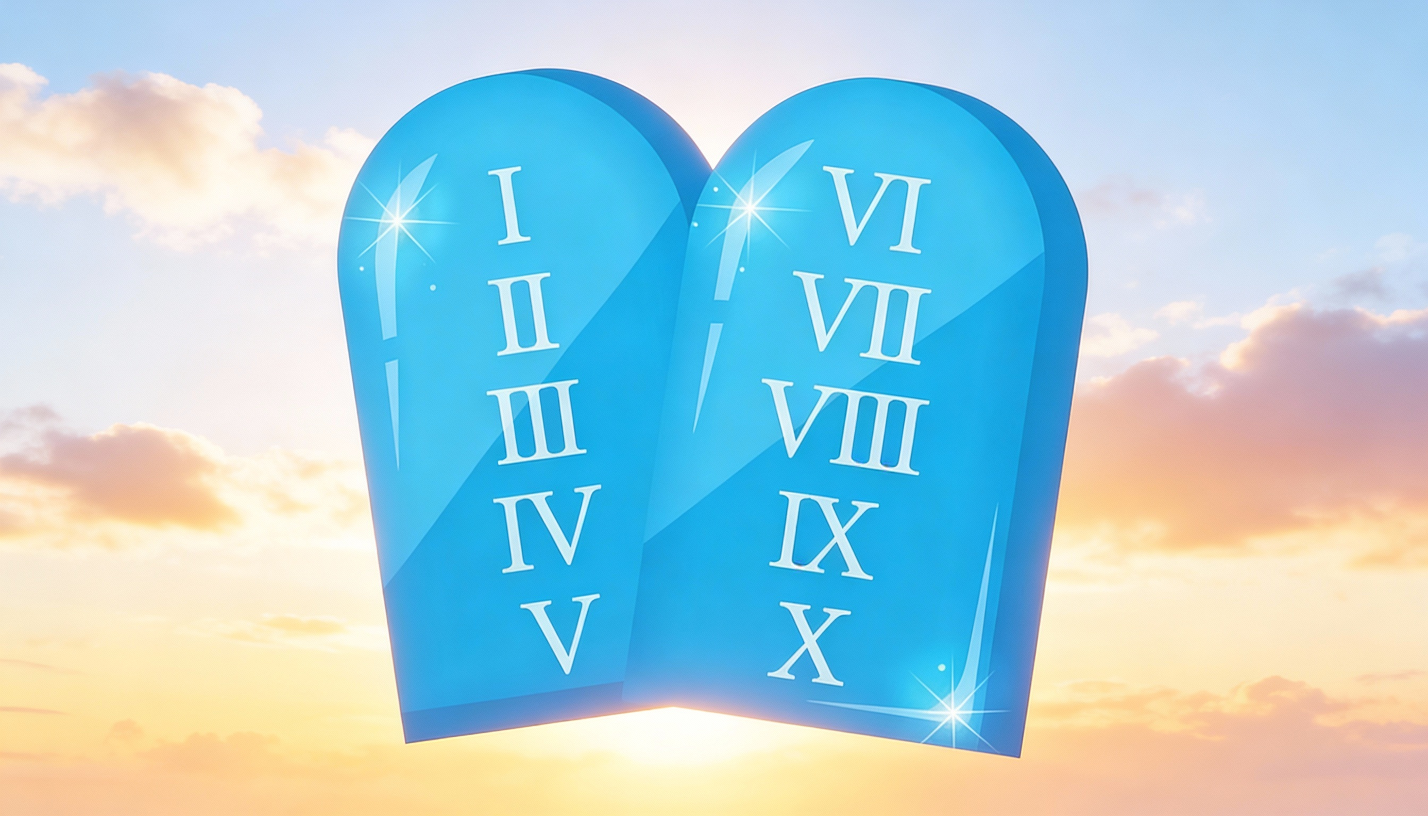
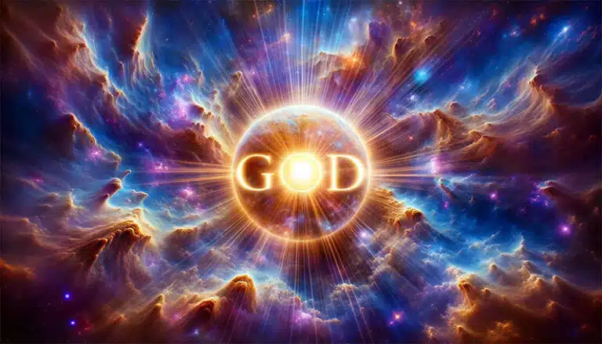
6
F
GOD IS PURE
THE LAW IS PURE
And every man that hath this hope in him purifieth himself, even as he is pure. (1 John 3:3)
The statutes of the LORD are right, rejoicing the heart: the commandment of the LORD is pure, enlightening the eyes. (Psalm 19:8)

Slide 9



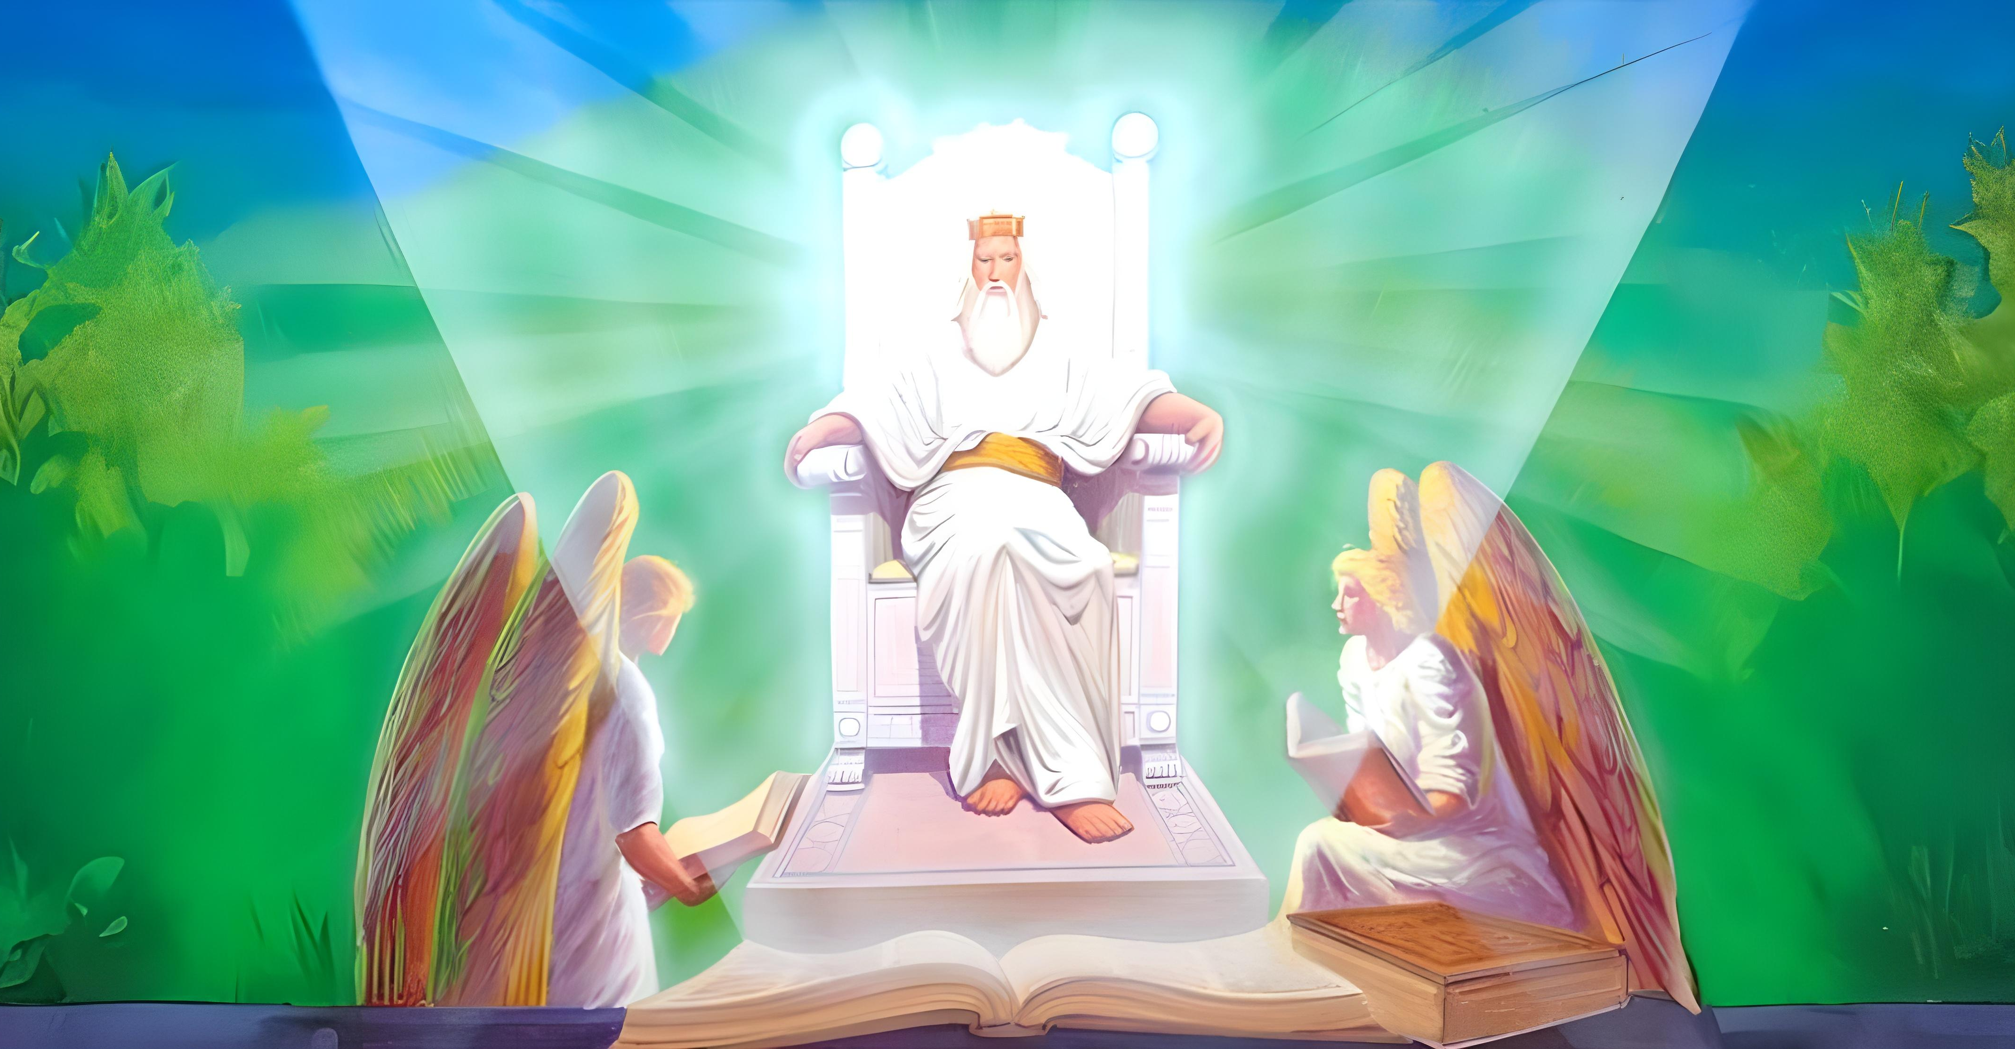
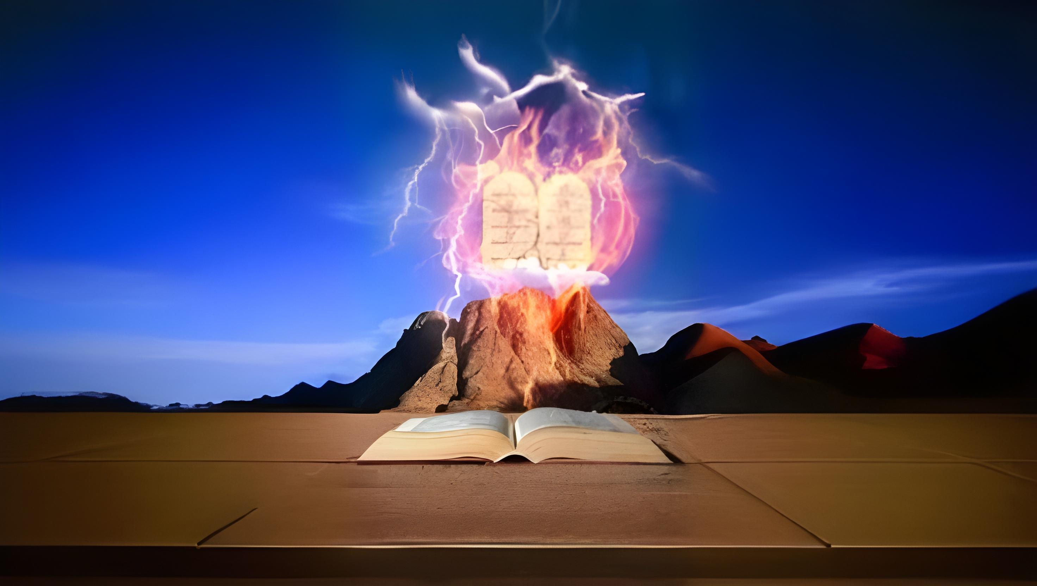
7
G
GOD IS TRUTH
THE LAW IS TRUTH
He is the Rock, his work is perfect: for all his ways are judgment: a God of truth and without iniquity, just and right is he. (Deuteronomy 32:4)
Thy righteousness is an everlasting righteousness, and thy law is the truth. (Psalm 119:142)

Slide 10



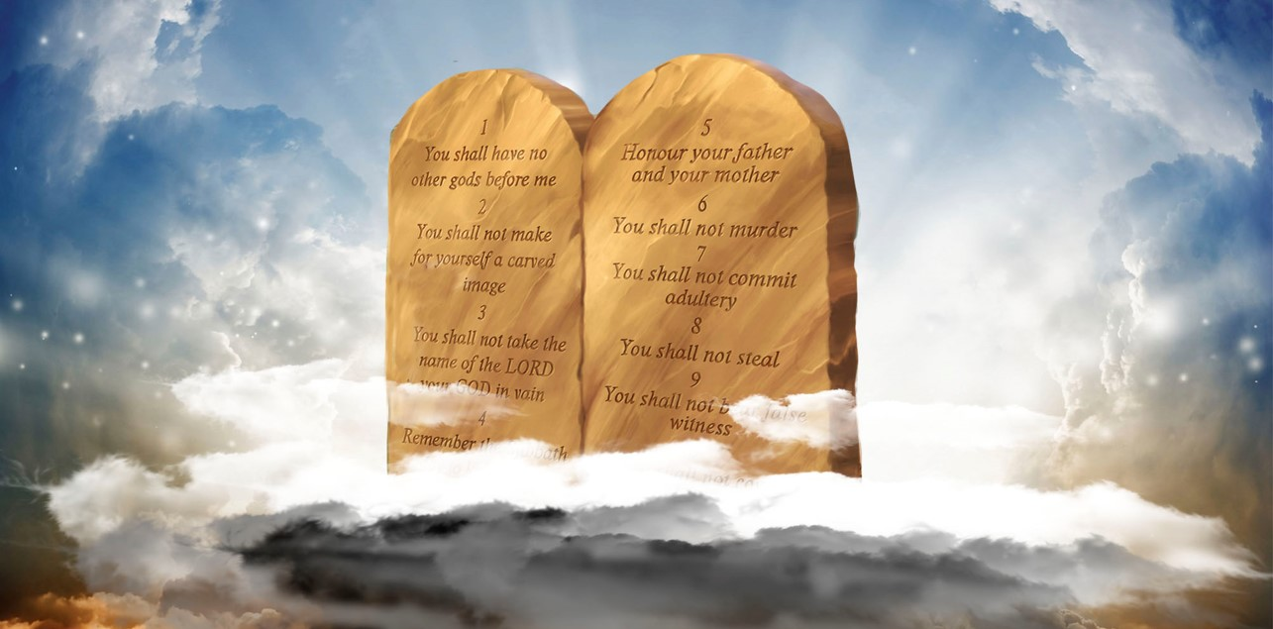
THE LAW IS ETERNAL
8
GOD IS ETERNAL
H
The works of his hands are verity and judgment; all his commandments are sure. They stand fast for ever and ever, and are done in truth and uprightness. (Psalm 111:7-8)
Hast thou not known? hast thou not heard, that the everlasting God, the LORD, the Creator of the ends of the earth, fainteth not, neither is weary? there is no searching of his understanding. (Isaiah 40:28)

Slide 11



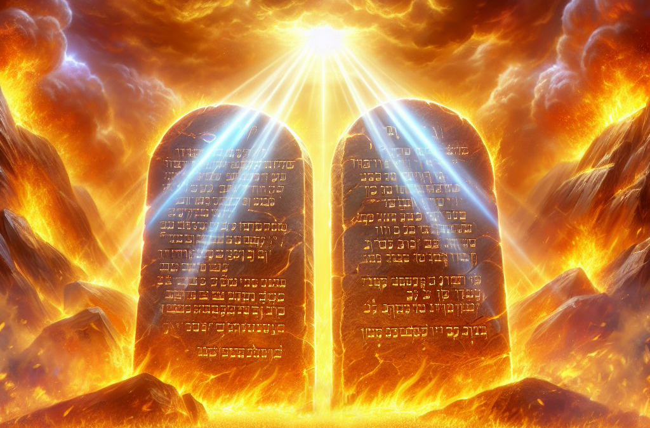
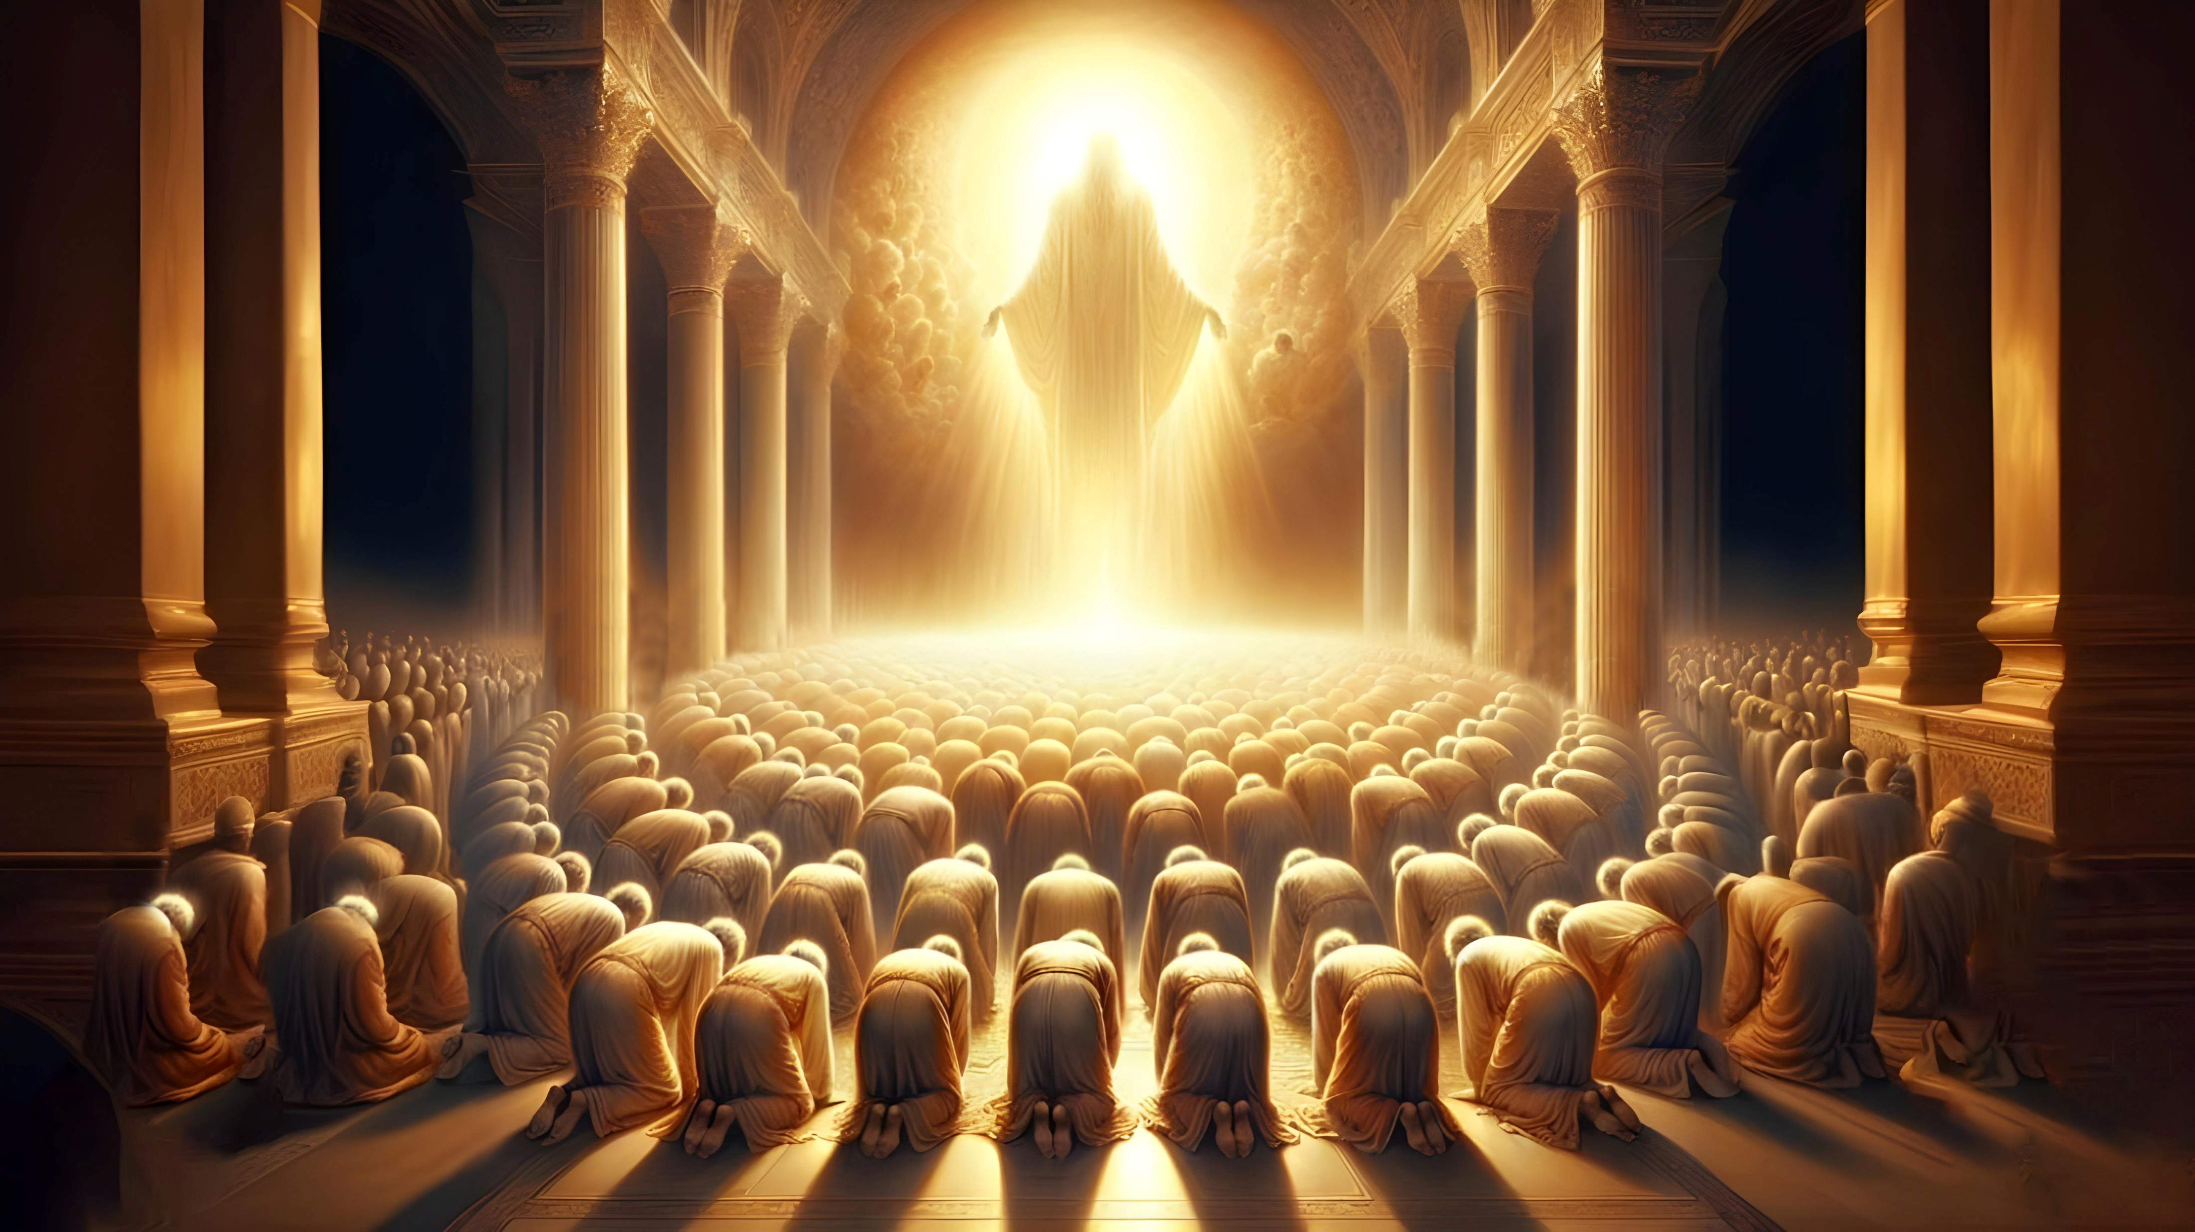
9
I
GOD IS SPIRITUAL
THE LAW IS SPIRITUAL
And did all drink the same spiritual drink: for they drank of that spiritual Rock that followed them: and that Rock was Christ. (1 Corinthians 10:4)
For we know that the law is spiritual: but I am carnal, sold under sin. (Romans 7:14)
God is a Spirit: and they that worship him must worship him in spirit and in truth. (John 4:24)

Slide 12


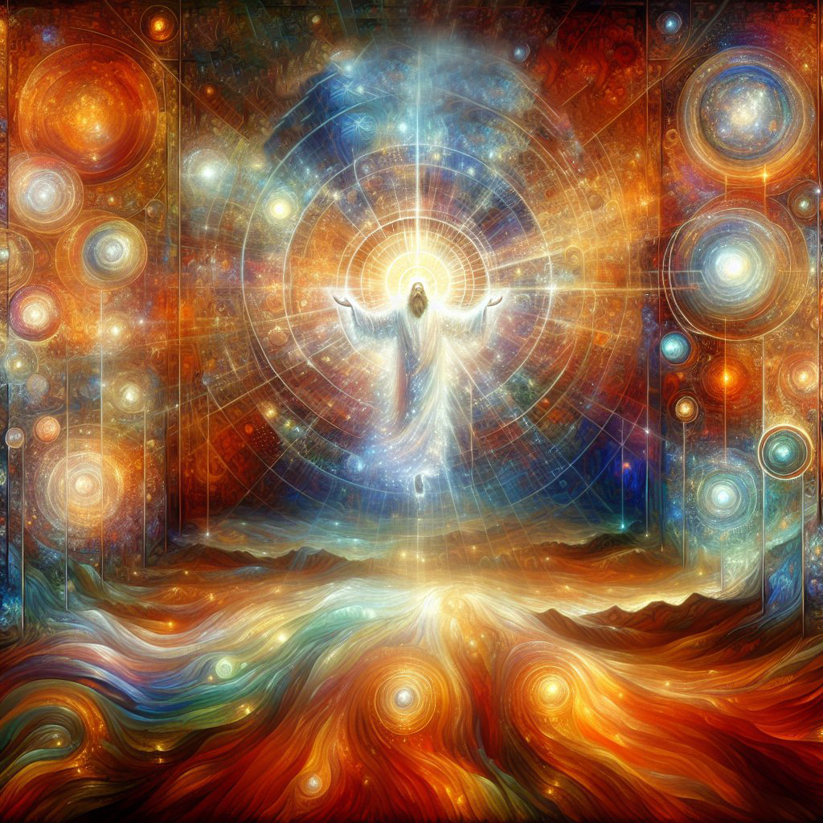
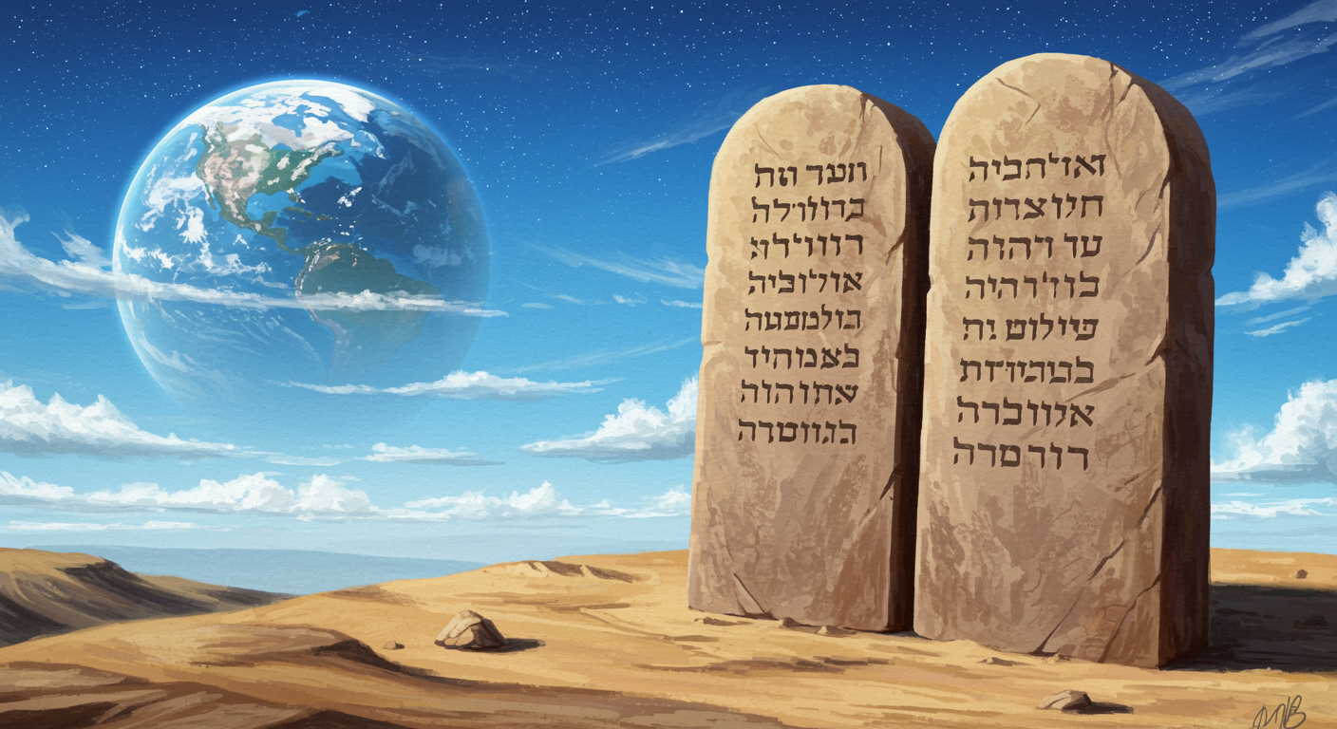
GOD IS UNCHANGING
THE LAW IS UNCHANGING
10
J
And it is easier for heaven and earth to pass, than one tittle of the law to fail. (Luke 16:17)
For verily I say unto you, Till heaven and earth pass, one jot or one tittle shall in no wise pass from the law, till all be fulfilled. (Matthew 5:18)
For I am the LORD, I change not; therefore ye sons of Jacob are not consumed. (Malachi 3:6)

Slide 13




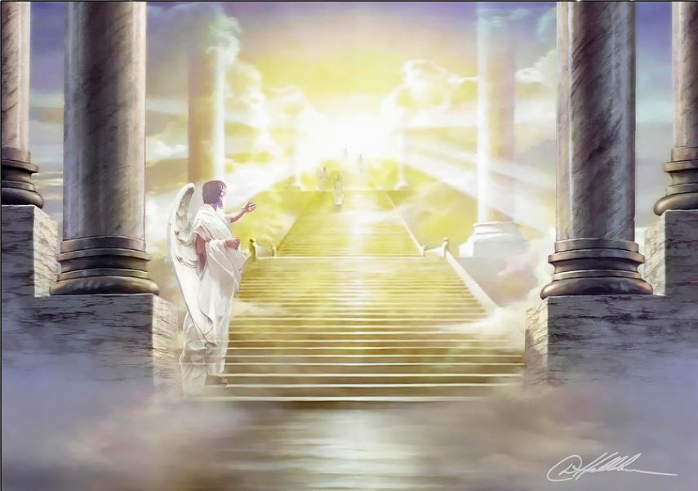
11
GOD IS LIGHT
THE LAW IS LIGHT
K
This then is the message which we have heard of him, and declare unto you, that God is light, and in him is no darkness at all. (1 John 1:5)
For the commandment is a lamp; and the law is light; and reproofs of instruction are the way of life. (Proverbs 6:23)

Slide 14

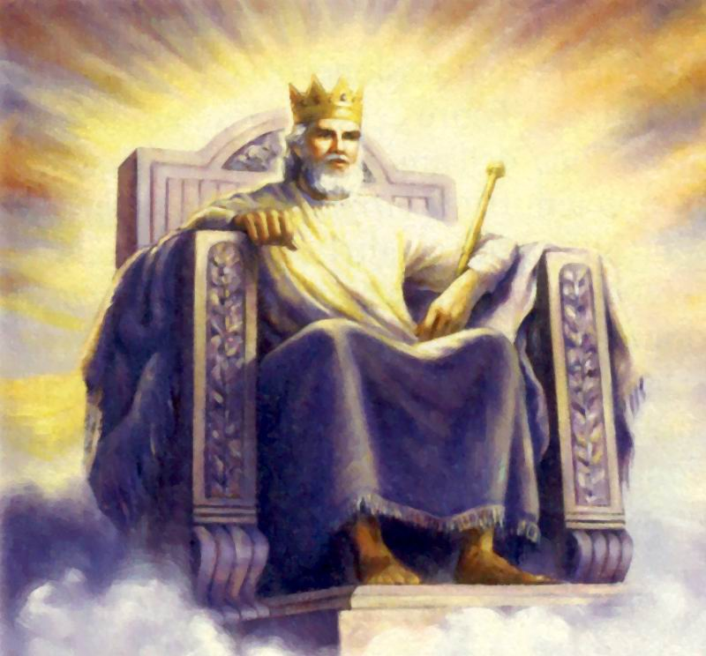
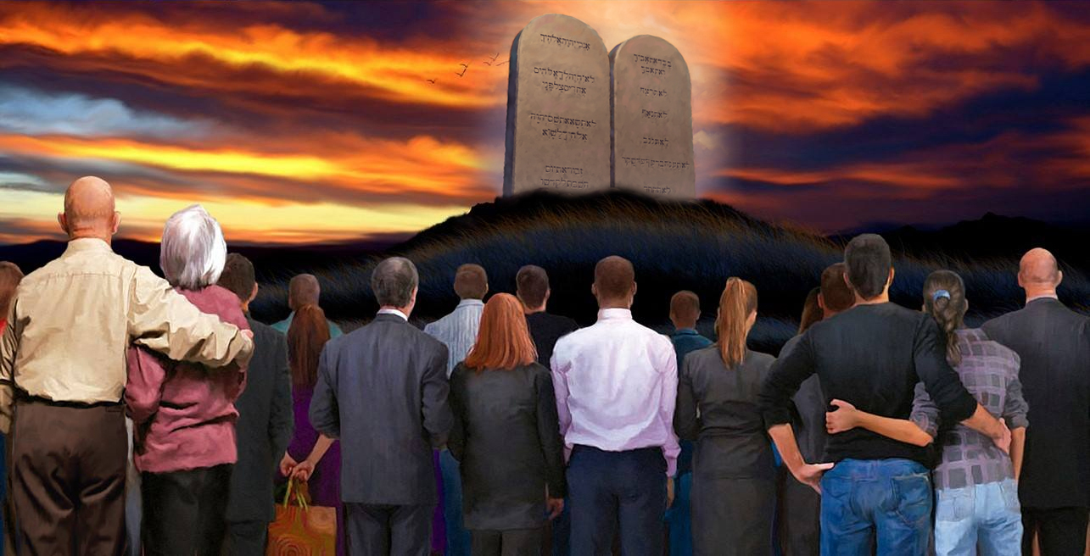
THE LAW IS RIGHT
L
12
GOD IS RIGHT
He is the Rock, his work is perfect: for all his ways are judgment: a God of truth and without iniquity, just and right is he. (Deuteronomy 32:4)
The statutes of the LORD are right, rejoicing the heart: the commandment of the LORD is pure, enlightening the eyes. (Psalms 19:8)

Slide 15
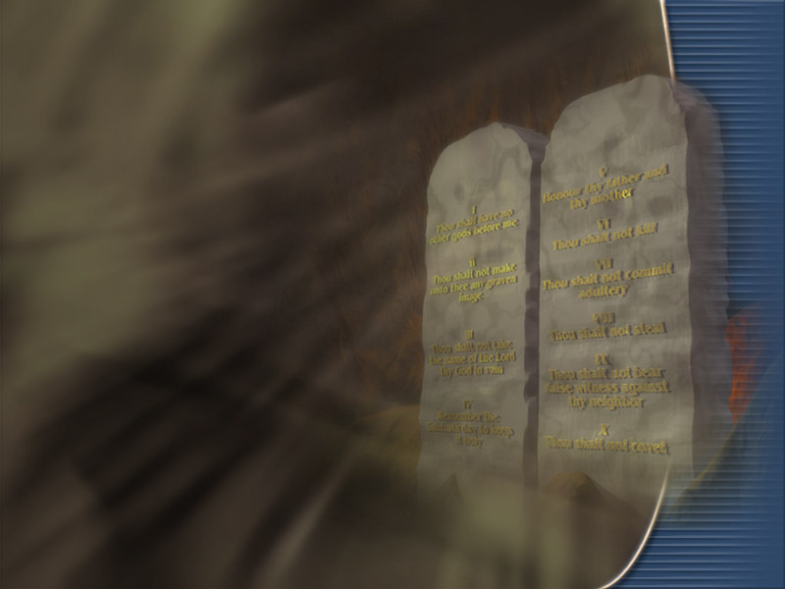
In setting aside the law of God, men know not what they are doing. God’s law is the transcript of His character. It embodies the principles of His kingdom. He who refuses to accept these principles is placing himself outside the channel where God’s blessings flow. The glorious possibilities set before Israel could be realized only through obedience to God’s commandments. The same elevation of character, the same fulness of blessing—blessing on mind and soul and body, blessing on house and field, blessing for this life and for the life to come—is possible for us only through obedience COL 305

Slide 16

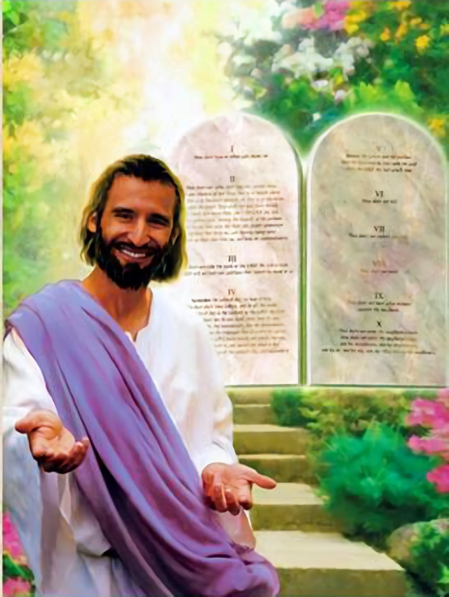
Through Jesus, God’s mercy was manifested to men; but mercy does not set aside justice. The law reveals the attributes of God’s character, and not a jot or tittle of it could be changed to meet man in his fallen condition. God did not change His law, but He sacrificed Himself, in Christ, for man’s redemption. “God was in Christ, reconciling the world unto Himself.” 2 Corinthians 5:19. DA 762
Christ came to our world to represent the character of God as it is represented in His holy law, for His law is a transcript of His character. Christ was both the law and the gospel.... CTr 339

Slide 17

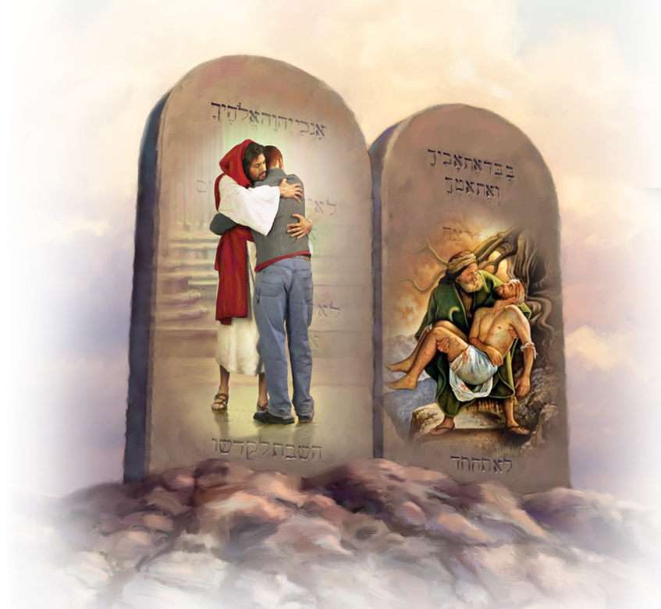
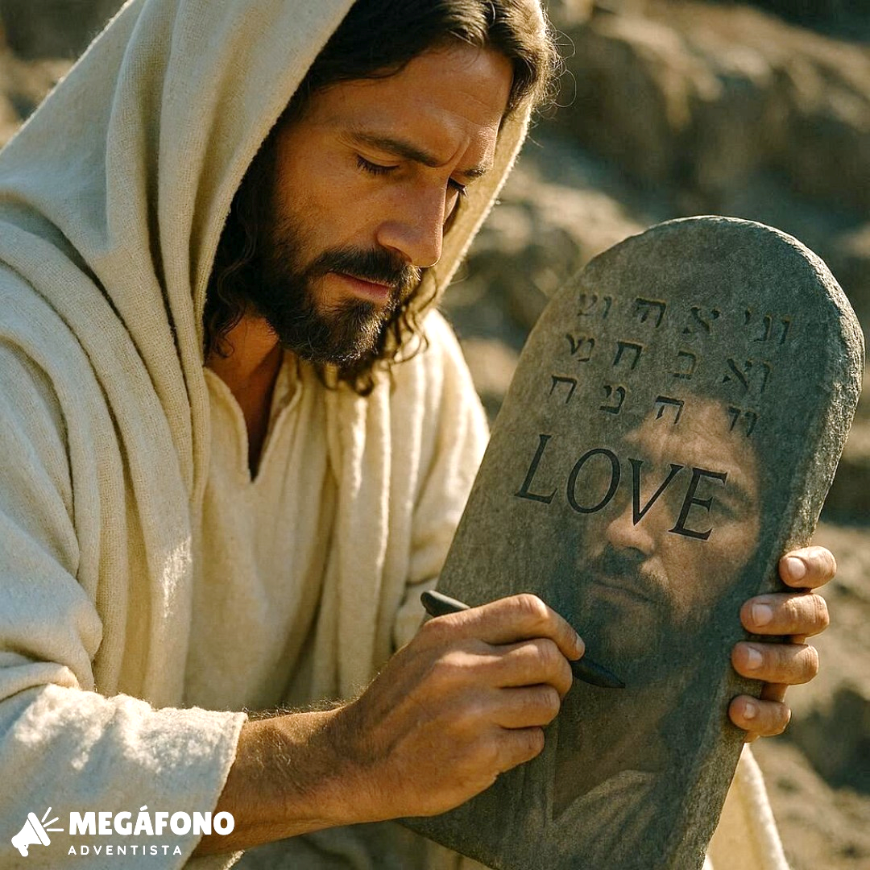
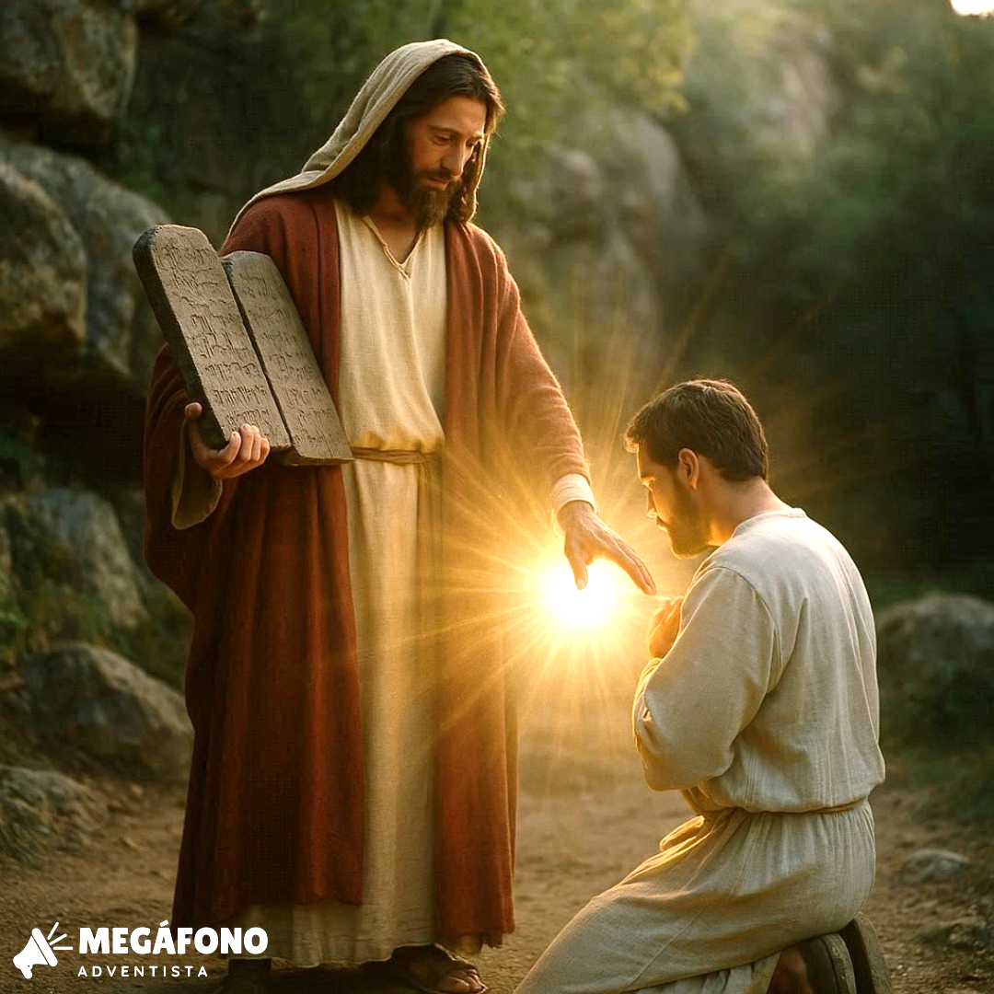
The law of God, from its very nature, is unchangeable. It is a revelation of the will and the character of its Author. God is love, and His law is love. Its two great principles are love to God and love to man. “Love is the fulfilling of the law.” Romans 13:10. The character of God is righteousness and truth; such is the nature of His law. Says the psalmist: “Thy law is the truth:” “all Thy commandments are righteousness.” Psalm 119:142, 172. And the apostle Paul declares: “The law is holy, and the commandment holy, and just, and good.” Romans 7:12. Such a law, being an expression of the mind and will of God, must be as enduring as its Author. GC 467
“God’s law is not a new thing. It is not holiness created, but holiness made known. It is a code of principles expressing mercy, goodness, and love. It presents to fallen humanity the character of God, and states plainly the whole duty of man.” FLB 86.

